Slide 1
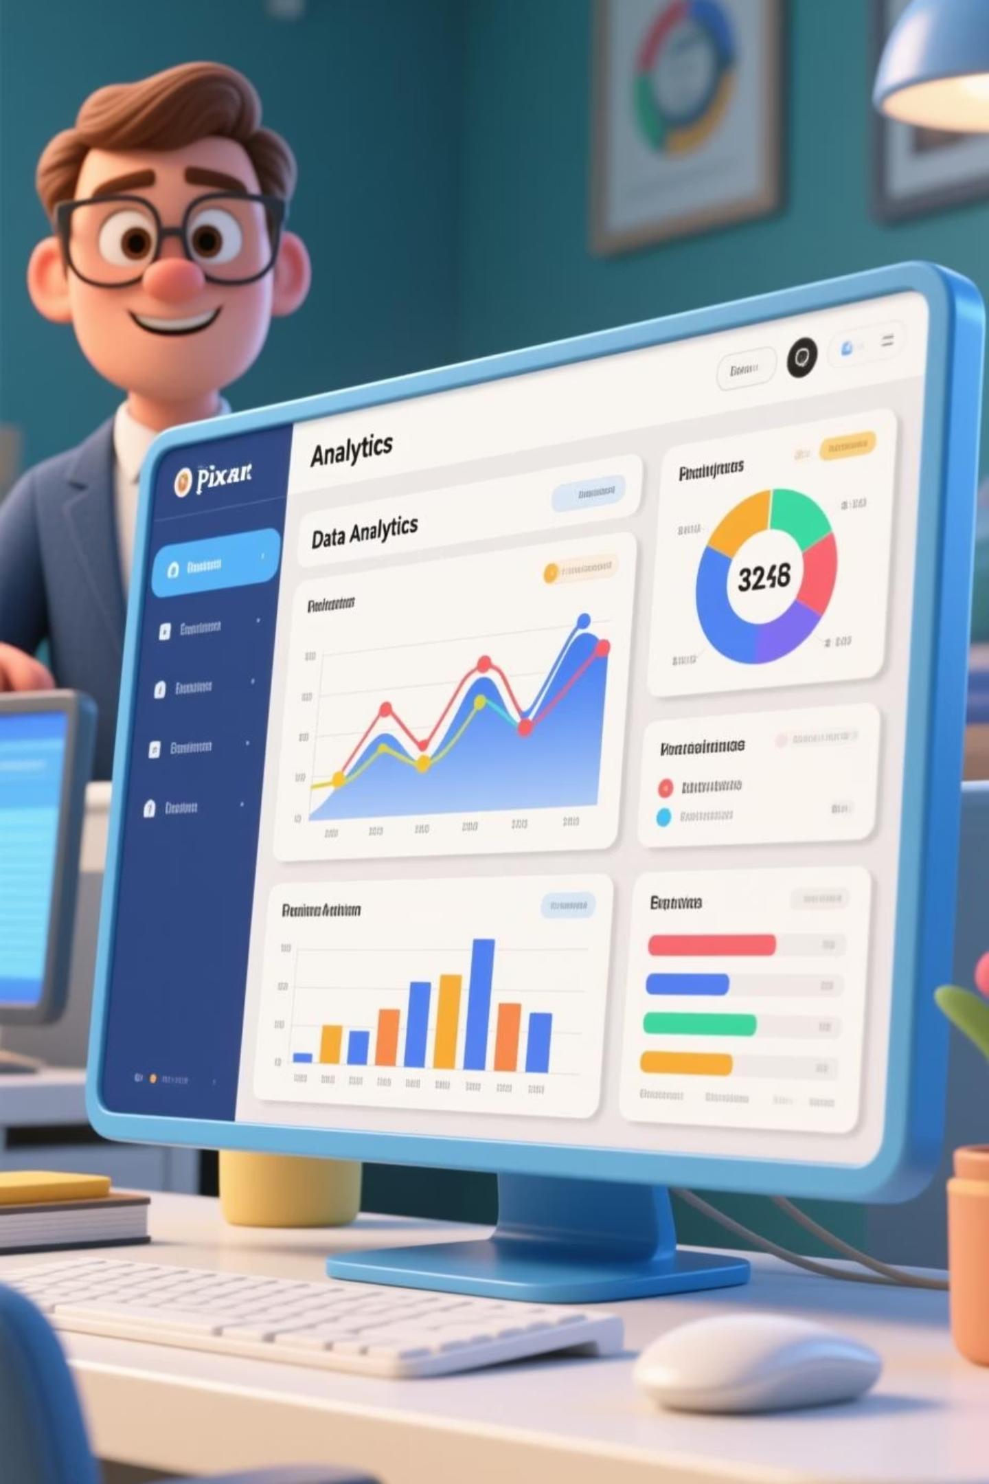
Customer Behavior Dashboard
Analyzing 3,900 purchases to uncover spending patterns, customer segments, and strategic opportunities

Slide 2
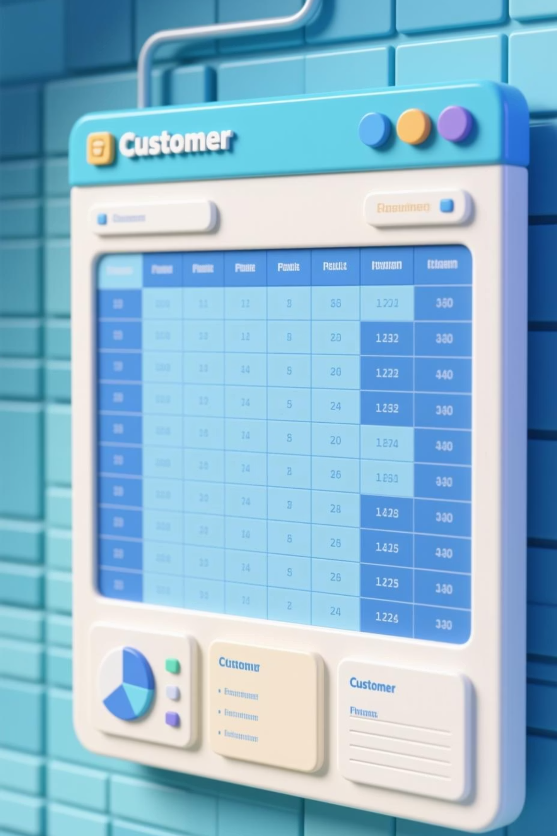
Dataset Overview
3,900 Purchases
18 Features
Complete transactional records analyzed
Demographics, purchase details, behavior metrics
37 Missing Values
Review Rating column imputed by category median

Slide 3
Data Preparation & Cleaning
01
02
03
Data Loading
Exploration
Standardization
Imported dataset using pandas
Analyzed structure and summary statistics
Renamed columns to snake_case format
04
05
Feature Engineering
Database Integration
Created age_group and purchase_frequency_days
Loaded cleaned data into PostgreSQL

Slide 4

Customer Demographics & Spending
Age Profile
Purchase Amount
Mean: 44 years
Mean: $59.76
Range: 18–70 years
Range: $20–$100
Median: 44 years
Median: $60

Slide 5
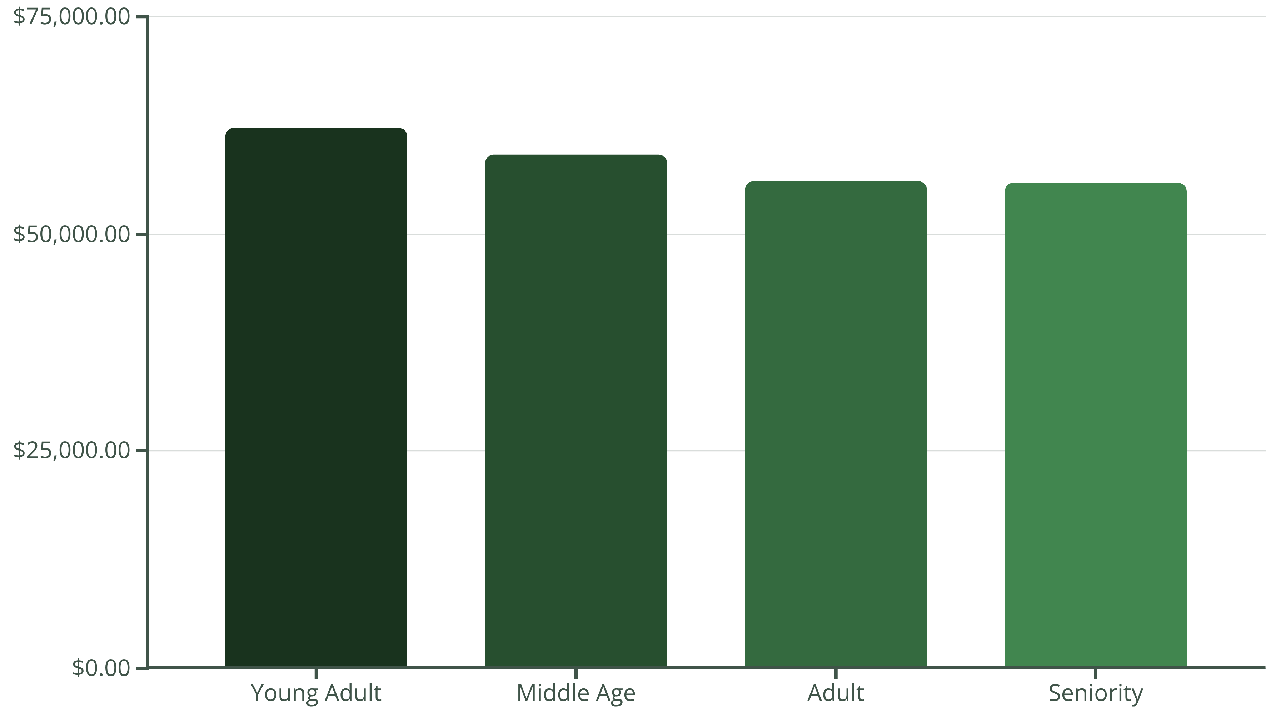
Revenue by Age Group
Young adults drive highest revenue. Target marketing efforts on this high-value segment.

Slide 6






Customer Segmentation
Returning
701 customers
Occasional purchasers
Loyal
3,116 customers
Core repeat buyers
New
83 customers
First-time buyers

Slide 7

Subscription Impact
Subscribers
1,053 customers | $59.49 avg purchase
Non-Subscribers
2,847 customers | $59.87 avg purchase
980 repeat buyers have subscriptions. Opportunity to convert non-subscribers through exclusive benefits.

Slide 8

Top Products & Shipping Preferences
Top 5 by Rating
Shipping Preference
Gloves: 3.86
Express: $60.48 avg
Sandals: 3.84
Standard: $58.46 avg
Boots: 3.82
Express users spend more—premium opportunity.
Hat: 3.80
Handbag: 3.78

Slide 9

Discount & Promo Strategy
2,223
675
3.75
Discount Applied
Express Shipping
Avg Rating
Strong customer satisfaction
57% of purchases used discounts
Premium shipping adoption rate
Balance discount frequency with margin control. High discount usage requires strategic review.

Slide 10

Strategic Recommendations
Boost Subscriptions
Promote exclusive benefits to convert non-subscribers
Loyalty Programs
Reward repeat buyers to move into "Loyal" segment
Review Discount Policy
Balance sales boosts with margin control
Targeted Marketing
Focus on young adults and express shipping users

